Slide 1
CUSTOMER DEMOGRAPHICS

Slide 2
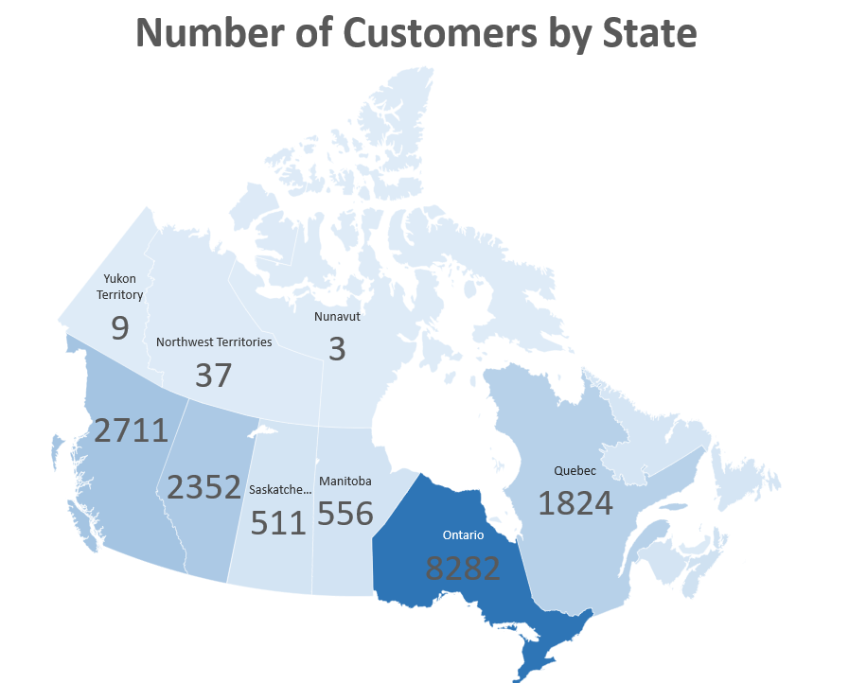
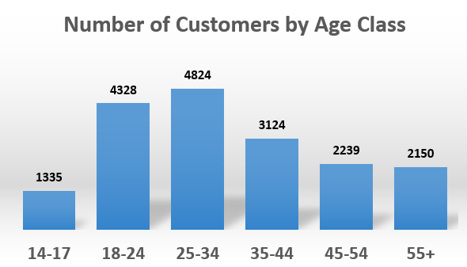
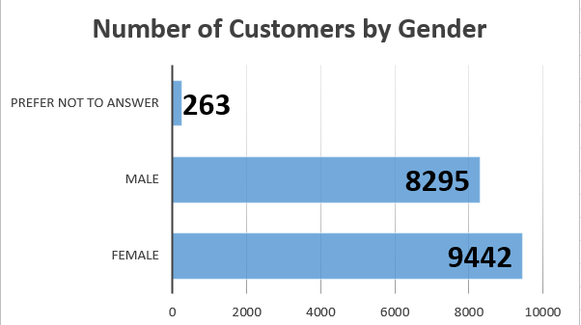
# Customers in Demographic

Slide 3
AVERAGE TOTAL POINTS

Slide 4
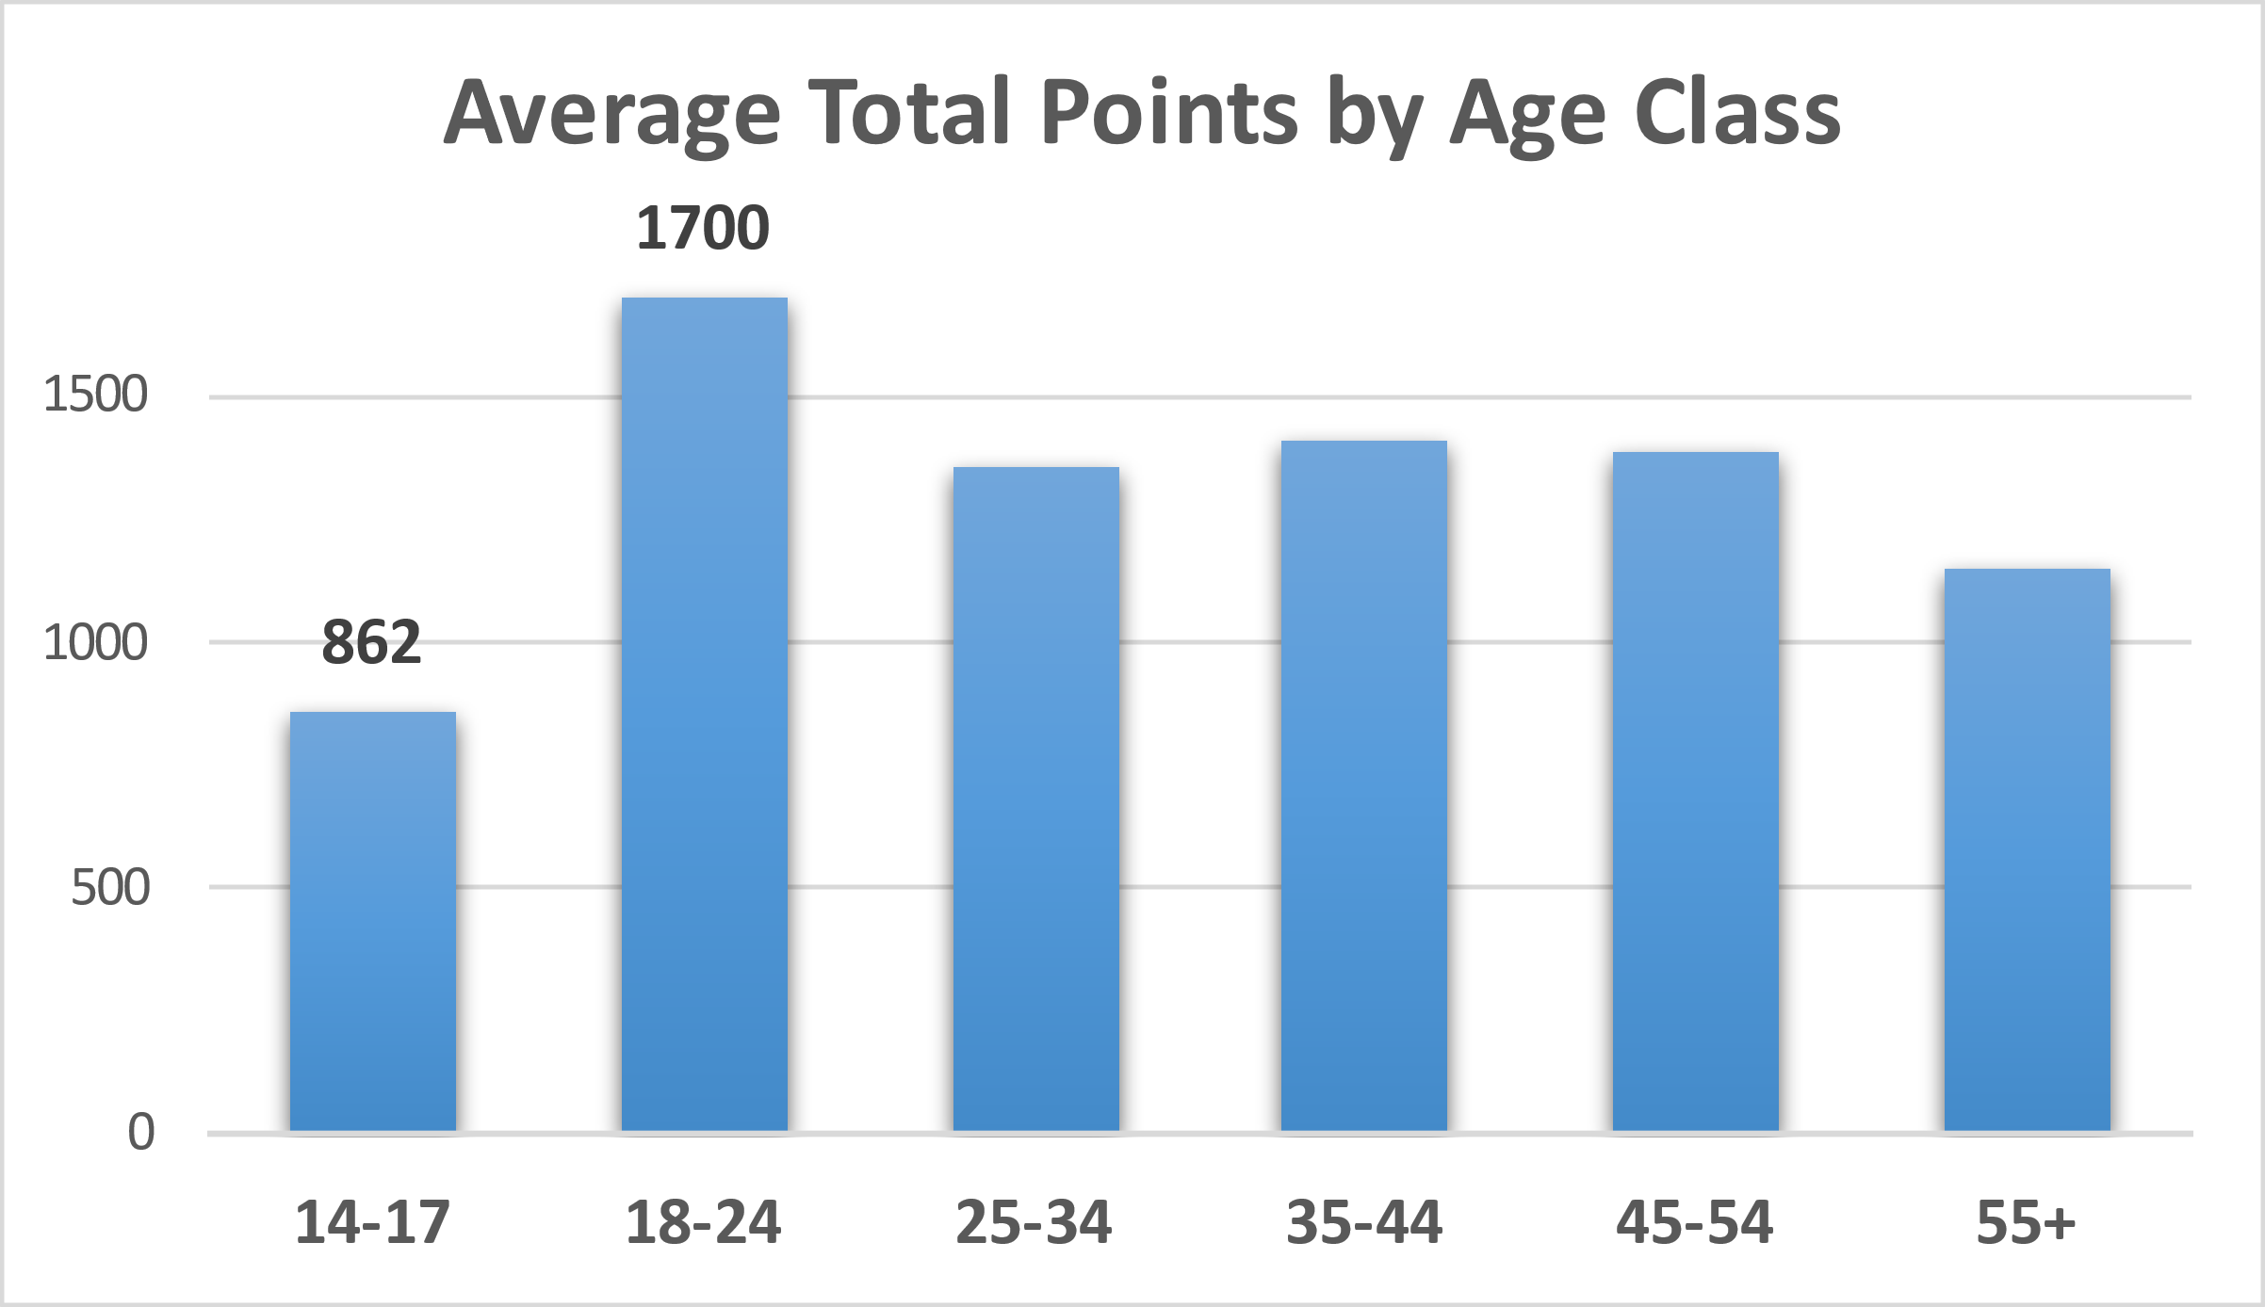
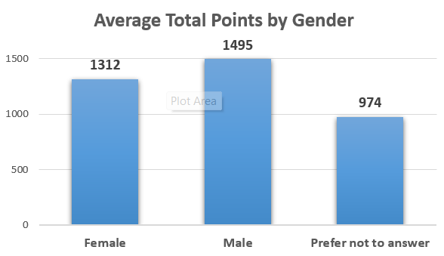
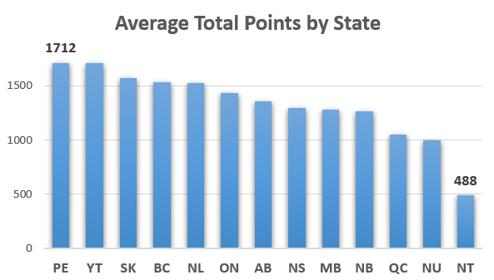
Average Total Points

Slide 5
AVERAGE NUMBER OF TRANSACTIONS
Notes:
Average Number of Transactions
We wanted to see how many times our customers have shopped with us.

Slide 6
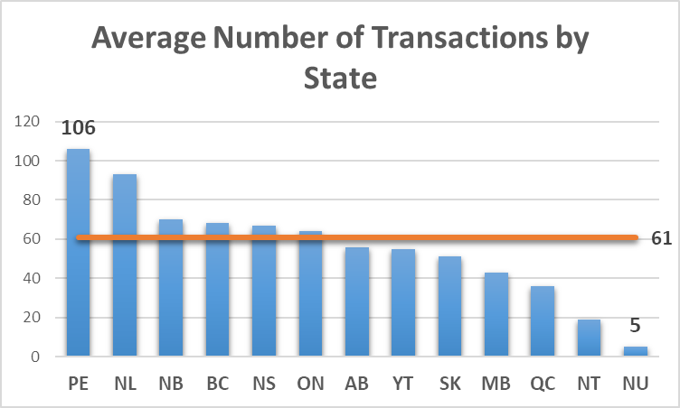
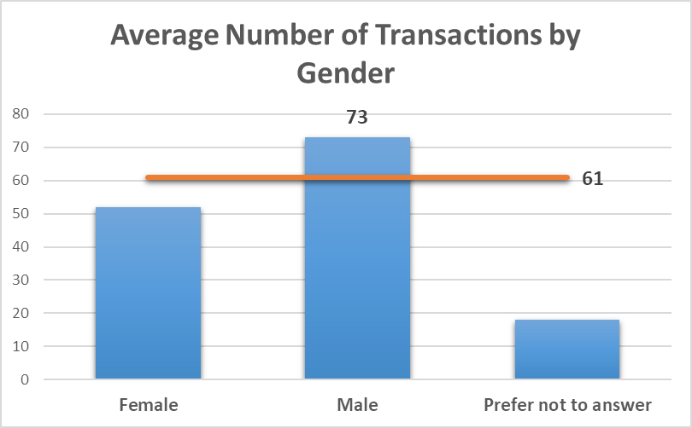
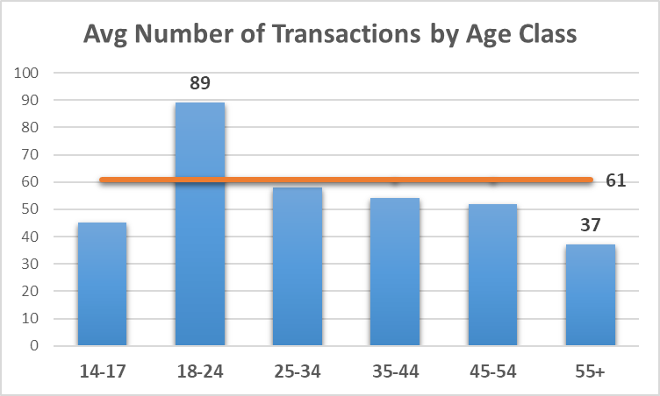
Average Number of Transactions

Slide 7

REPEAT PURCHASE RATE
Percentage of customers who made a purchase more than once in a given period.
As an example;
2000 total customers
650 made two or more purchases during 2022
Repeat Purchase Rate = (650/2000) x 100 = 32.5%

Slide 8
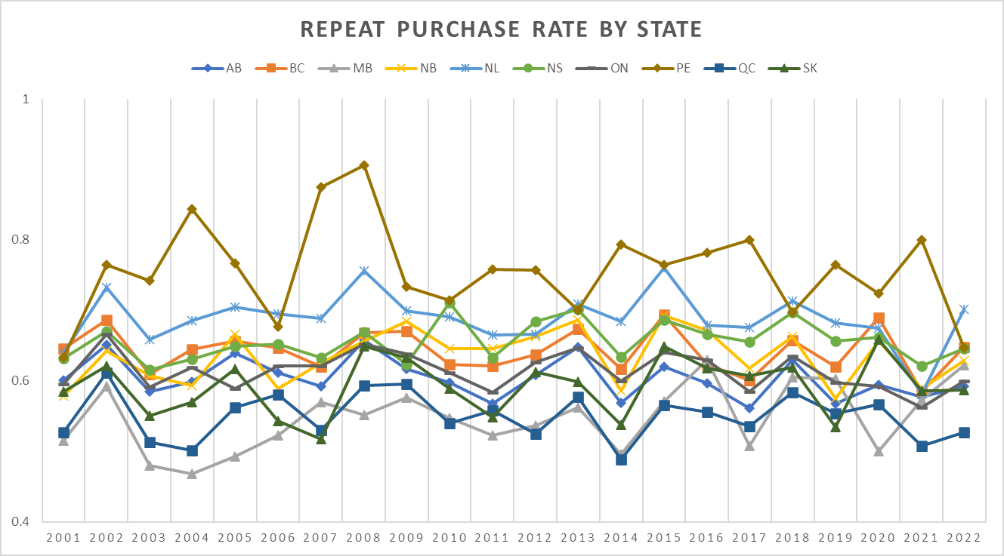

Slide 9

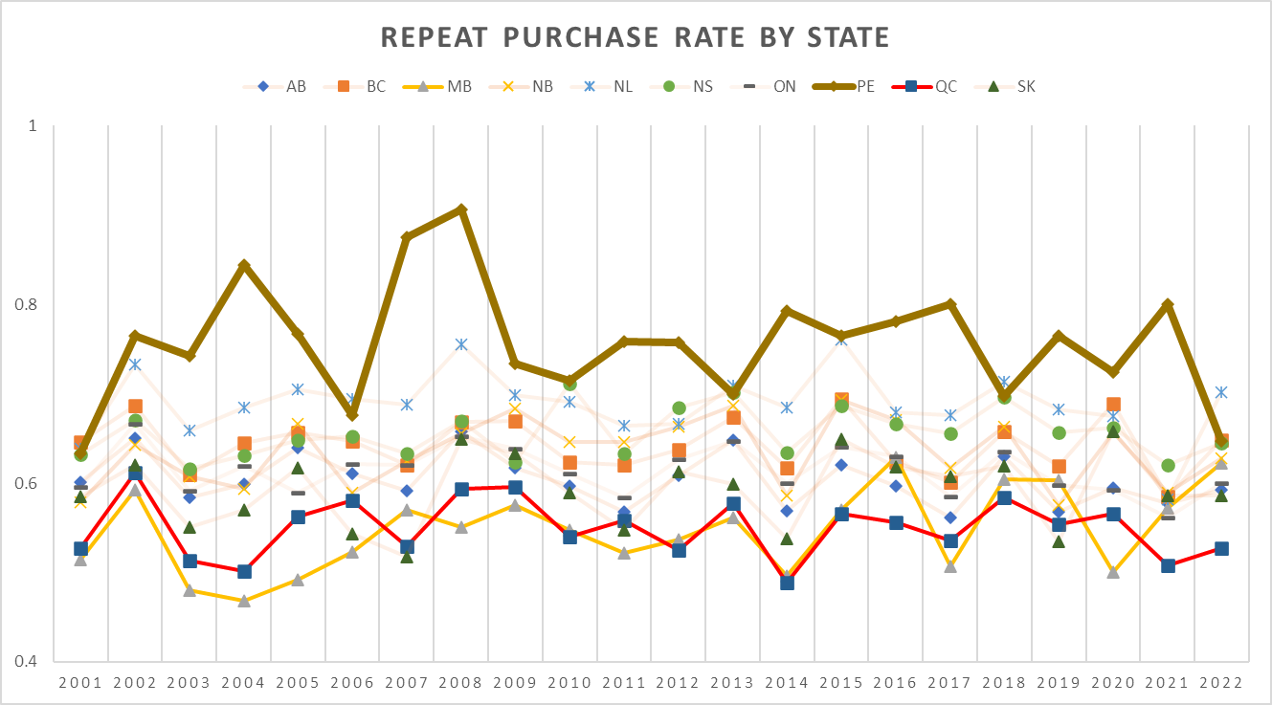
Insights
The range is between 45% and 90%.
90%
PE has the highest overall rate. The lowest overall rates are in MB and QC.
The rate peaked during 2008 and started falling gradually to the same level back to the start of 2001.

Slide 10
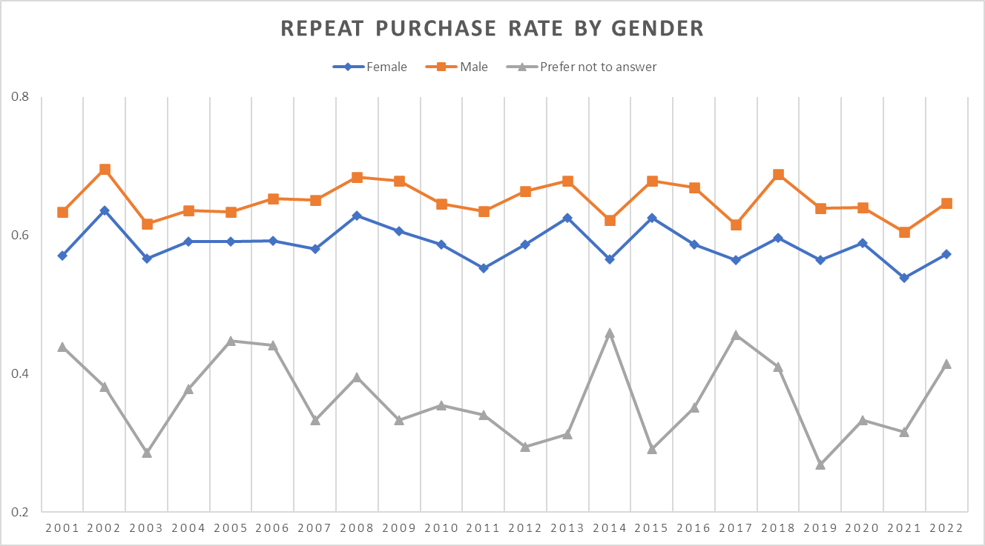
Insights
The range is between 25% and 70%.
Male customers have the highest rate averaging 65%. Prefer not to answer is the lowest averaging 35%.
The trend is similar for each group, except for 2014 and 2017. Female and Male decreases while Prefer not to answer increases significantly.

Slide 11
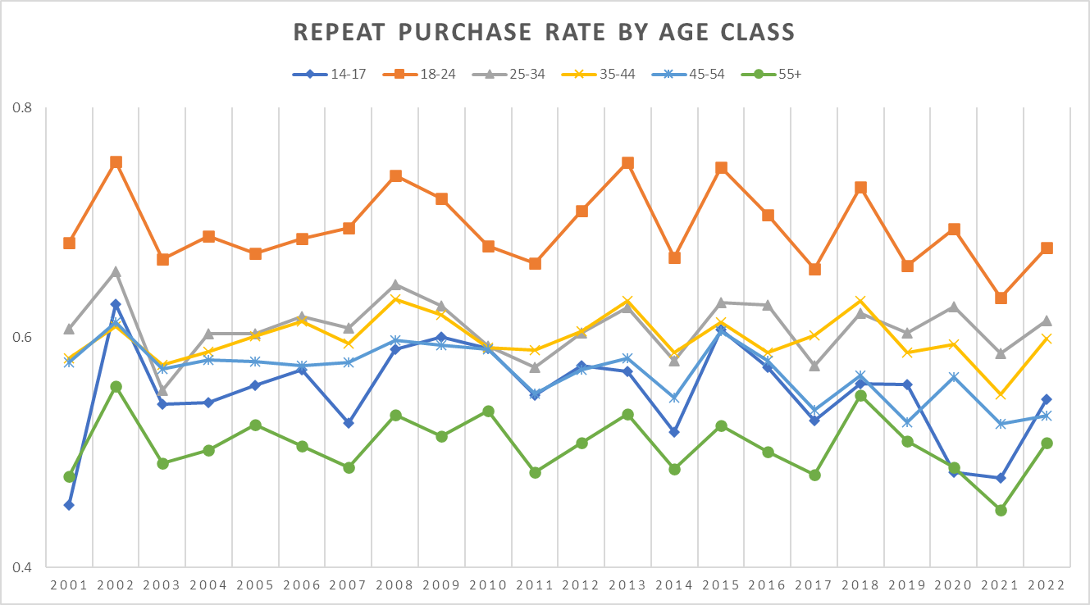
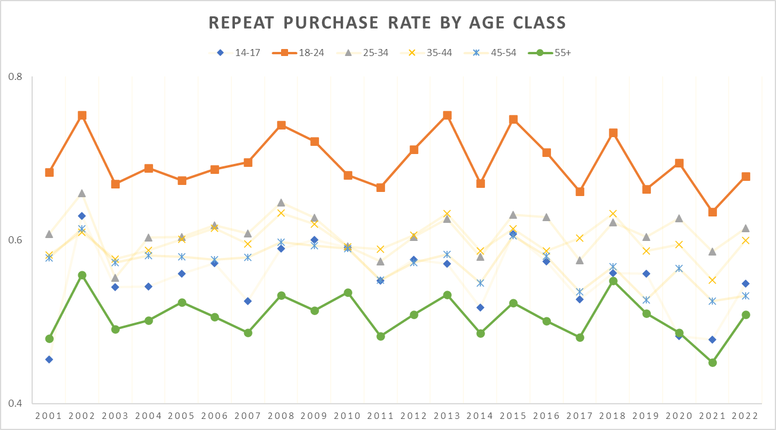
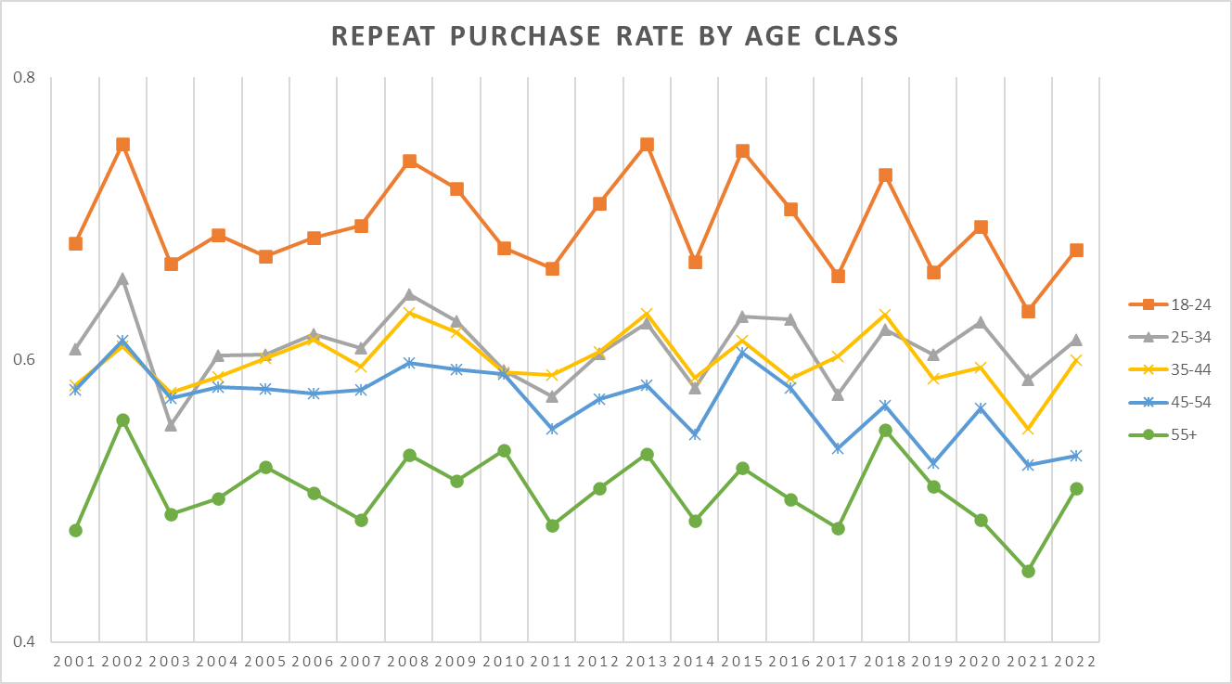
Insights
The range is between 45% and 75%.
18-24 has the highest rate averaging 70%. 55+ has the lowest rate averaging 50%.
Except for the class 14-17, the repeat purchase rate decreases as age increases.

